Slide 1
CSCI 5922 Spring 2020
Project Presentations

Slide 2
Instructions
Please add a title slide stating your project title and team members’ names.
Add a few slides to support a 3-5 minute presentation about your project.

Slide 3
Morphological Inflection Prediction
Cpt. Zak Boston, Andy Gerlach, “Big Money” Mike Lanciloti

Slide 4
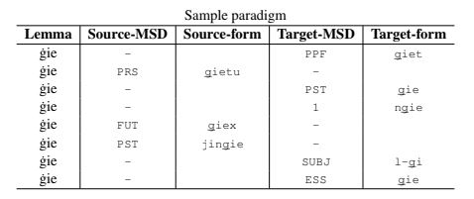
SIGMORPHON
Special Interest Group on Computational Morphology and Phonology
Has generated annual tasks for inflection generation since 2016
Each year provides progressively less data and less structured data

Slide 5
Morphological Inflection
Morphological inflection is the process of changing the base form of a word, its lemma, into a new form which expresses tense, aspect, person, number, etc. e.g. Eat 1;PST -> ate
For this task participants must train a model on a small set of lemmas and corresponding sets of inflections
Then use the model to produce inflections given unseen lemmas and their target form

Slide 6
Neural Implementation
Seq2seq encoder-decoder using keras LSTM layers
Applying regularization techniques to improve performance and prevent overfitting
We will experiment with hyperparameters for best results

Slide 7

Named Entity Recognition on Code-switched text
Project Members: Harel Biggie, Mary Martin, and Elizabeth Spaulding
Notes:
Harel, Mary, and Elizabeth

Slide 8

The task
Code-switching: speaking two or more languages in one utterance
Named entity recognition: locate and classify named entities in text
Our approach:
BiLSTM
BERT
Multilingual BERT
Organization
Product
Notes:
Harel, Mary, and Elizabeth

Slide 9
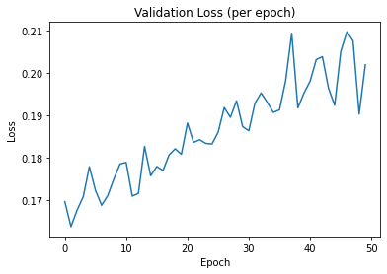
Preliminary Results & Challenges
 | F1 Score
BiLSTM | 52.07
BERT | 60.72
M-BERT | 56.71
Shared task baseline model | 53.2802
Shared task best model | 63.7628
Data loss
Original training set size: ~50,000 tweets
Training set size now: ~35,000 tweets
In general, validation loss increased as F1 score increased
‘O’ tag occurs 96.9% of the time
Model probably began to guess ‘O’ most of the time with a very high confidence
Tag weights did not improve performance 😓
M-BERT performs worse than BERT
Too many languages competing for space in the shared vocabulary?
Notes:
Harel, Mary, and Elizabeth

Slide 10
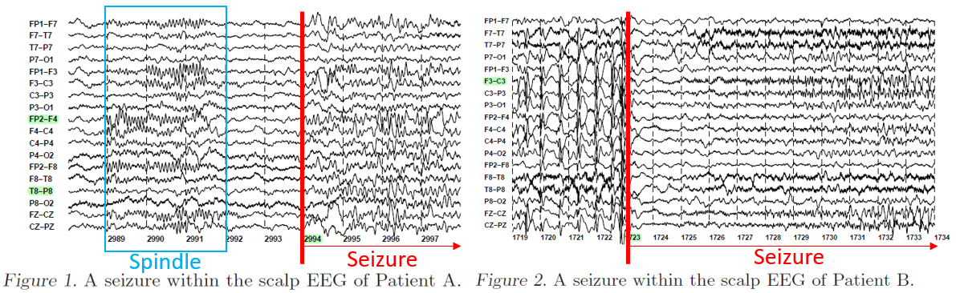
Anomaly Symptom Detection using Time-series Brainwave Signal Data
Project Members: Taeho Kim and Jaeyoung Oh

Slide 11
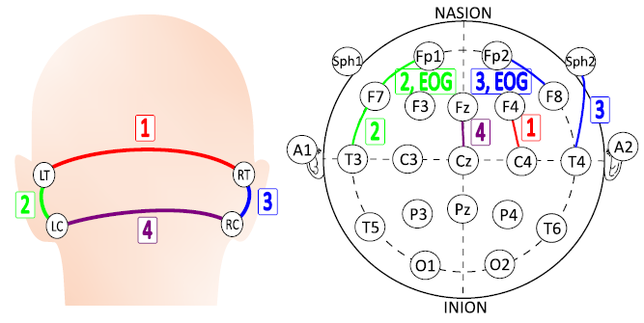
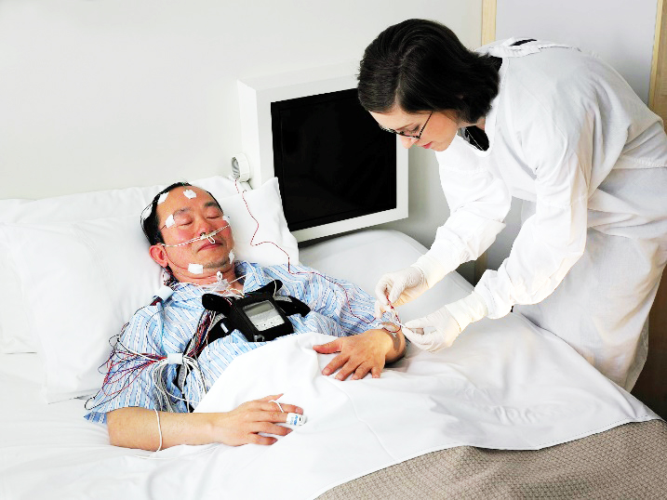
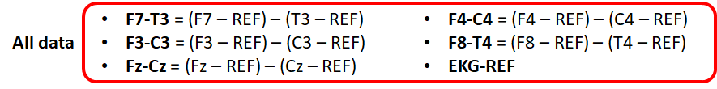
The task
Decrease the number of electrodes and detect anomaly symptoms
Brainwave signal processing
Extract multiple time-series features
Focus on CNN + LSTM models

Slide 12
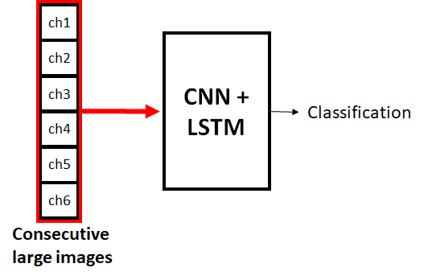
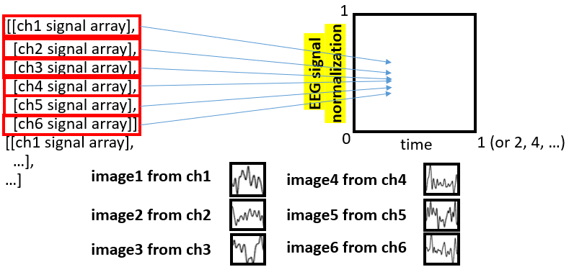
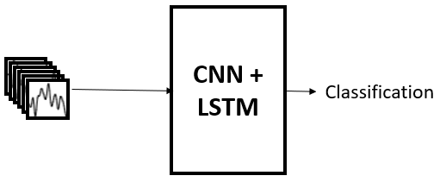
Architecture
U-Net
Fully Convolutional Network
RNN Encoder-Decoder
Batch normalization
Dropout
activation functions

Slide 13
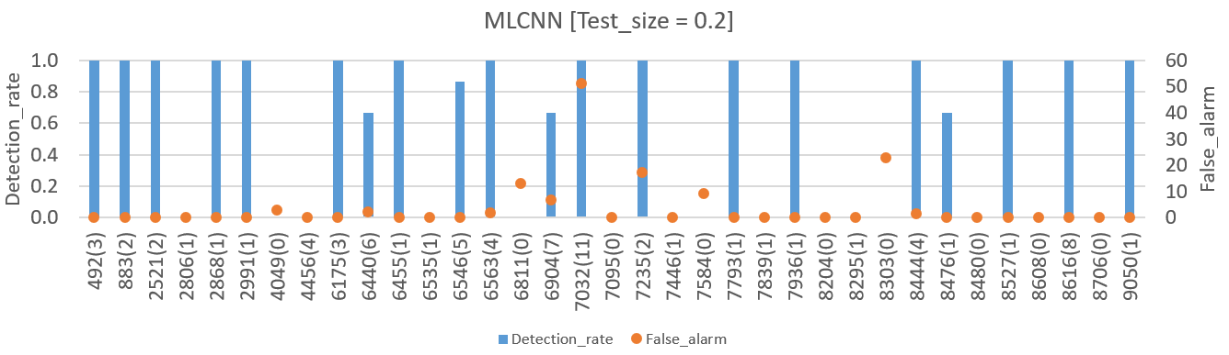
Challenges & Current result
Depending on the data quality, the classification performance is different
Need enough seizure cases, signals from properly attached electrodes
Seizure occurrence and duration are measured by Doctor (Ground-truth is not perfect)
Different patients have different symptoms and locations of seizure
Limited electrode position - cannot detect all kinds of seizures
3D tensor input / adding RNN - long training time
Seizure number
patient ID

Slide 14
Image Inpainting
Final Project: Neural Networks and Deep Learning
Krishna K Chaitanya
Shreshtha Pankaj
Keval Shah
Dhanendra Soni

Slide 15
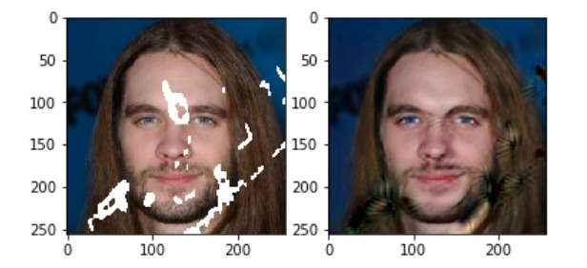
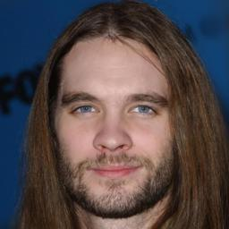
Problem Statement
Formally, Inpainting is a process where missing or damaged parts of an artwork are filled in to present a complete image that is closely similar to the original. Through this project, we wish to use the power of Deep Learning to replace missing portions of a digital image with meaningful content.
Damaged Input Image Inpainted Imaged Original Complete Image
?

Slide 16
Approach
There are broadly two ways to do achieve successful image inpainting:-
Conventional Computer Vision based algorithms
Using GAN (Generative Adversarial Networks) based Deep Learning model
Structure Knowledge
Texture Knowledge
In GAN based learning, a CNN based context encoder-decoder is used to fill out the patches in the images. The output of encoder-decoder is used as input for GAN to generate a realistic image.
Used CelebHQ(256*256) dataset for training and testing purposes with a 95:05 split with a total of 30K images.
Notes:
In GAN based learning, a CNN based context encoder-decoder is used to fill out the patches in the images.
The output of encoder-decoder is used as input for GAN to generate a realistic image.
For monitoring the performance of the model we use tensorboard to graph all the losses and we also plot the Image PSNR after each epoch (Peak Signal to noice ratio) to know the quality of the image generated by the model.
In the next slide I am going to explain the architecture
We spent days over fixing the ID-MRF loss in VGG layer which was eventually being used in the local and global losses. [Shrestha]

Slide 17
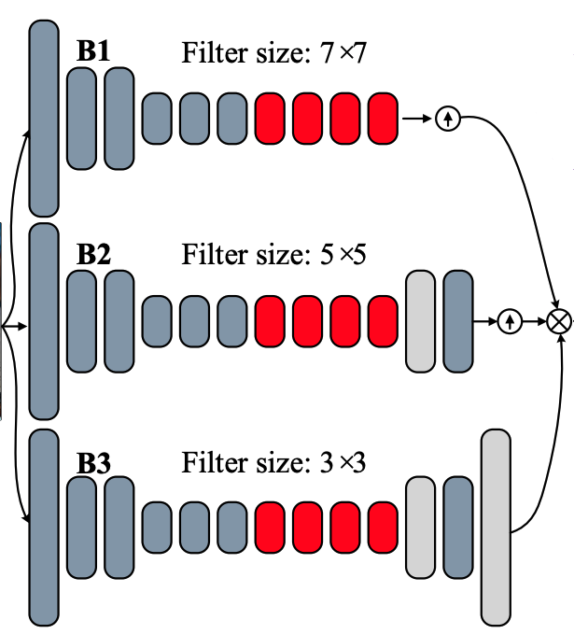
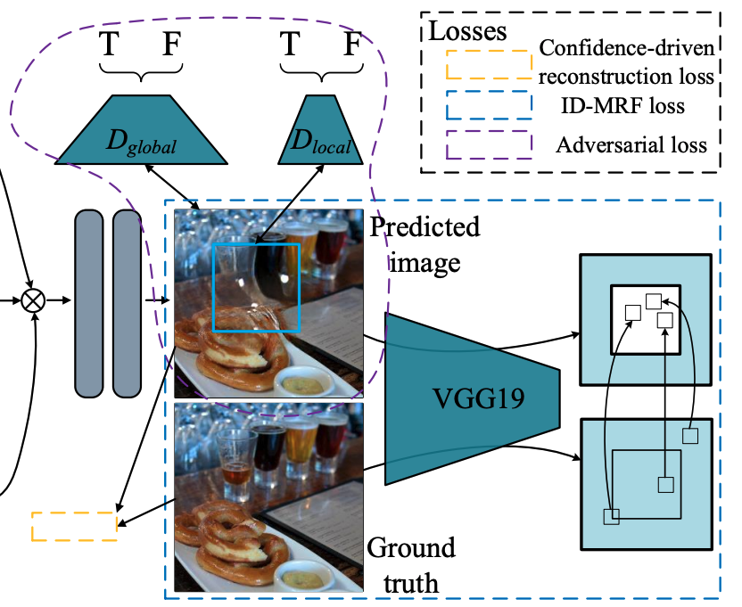
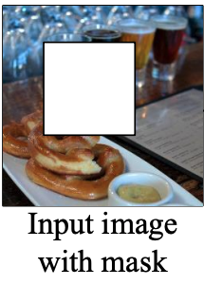
Architecture
Notes:
The generator network consists of n (n = 3) parallel encoder-decoder branches to extract different levels of features from input. They are concatenated at the end and the output is fed into GANS.
The global & local discriminators for adversarial training
The ID MRF loss is used the fine tune the generated images

Slide 18
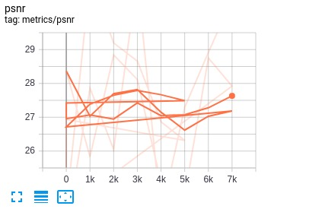
Results
Damaged Input Image Inpainted Imaged Original Complete Image
?
Notes:
Our average PSNR is 27.4. The reference paper we followed, reports PSNR value to be 25.70. We changed the normalization technique they were using from NORM_MINUS_PLUS_ONE to NORM_ZERO_ONE. I believe this led to improvement in PSNR. With every epoch there is an marginal improvement in the PSNR.
The below images stacked horizontally shows the image with mask, predicted image and ground truth image

Slide 19
Simulation Frameworks and Implementation
Hardware:-
Nvidia Tesla K80 and Tesla V100 GPU based VM on GCP
A laptop with RTX 2070 GPU
Software and Libraries:-
Python 3 and standard libraries for image operations - openCV
Author’s code - Tensorflow 1
Our Implementation - Keras 2.3 on TensorFlow 2.1 Backend
Scikit Image for generating metrics like PSNR
Notes:
Training time.
5 epochs K80 - 18 hours
5 epochs V100 - 6 hours

Slide 20
Challenges
Converting the codebase from TensorFlow V1 to TensorFlow V2
Lots of issues in converting the model to V2.
EX: Using the output of intermediate VGG layers to compute the local and global losses.
Improving the PSNR of output images
Improving the visual aesthetic of predicted images
Notes:
We spent days over fixing the ID-MRF loss in VGG layer which was eventually being used in the local and global losses.

Slide 21
References
[1] Yi Wang, Xin Tao, Xiaojuan Qi, Xiaoyong Shen, Jiaya JiaImage. Inpainting via Generative Multi-column Convolutional Neural Networks
Original code in tensorflow 1 - Link

Slide 22

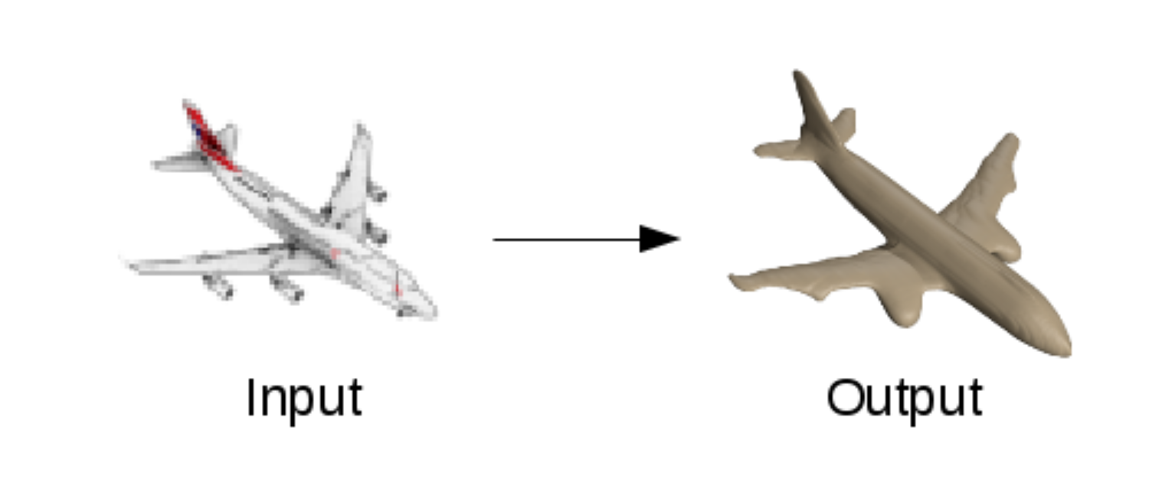
Occupancy Network based 3D Image Reconstruction using Single-Depth View
Team Members: Sourav Chakraborty, Tanmai Gajula, Amit Baran Roy, Aparajita Singh

Slide 23
THE TASK
Reconstructing the complete 3D structure of an object, given a single 2.5D depth view as input.
Approach: 3D-RecGAN++ - Based on Generative Adversarial Networks.
Datasets: Train and test sets generated from ShapeNet Database.
Input / Output representation: Voxel grid
Applications in computer graphics, computer animation, computer vision, medical imaging, computational science, digital media.

Slide 24
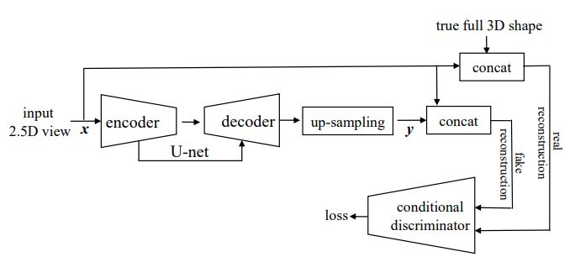
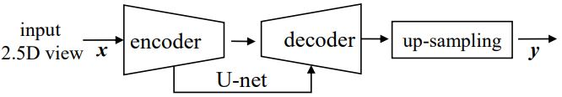
ARCHITECTURE - 3D-RecGAN++
Training Architecture
Testing Architecture
https://arxiv.org/pdf/1802.00411v2.pdf

Slide 25
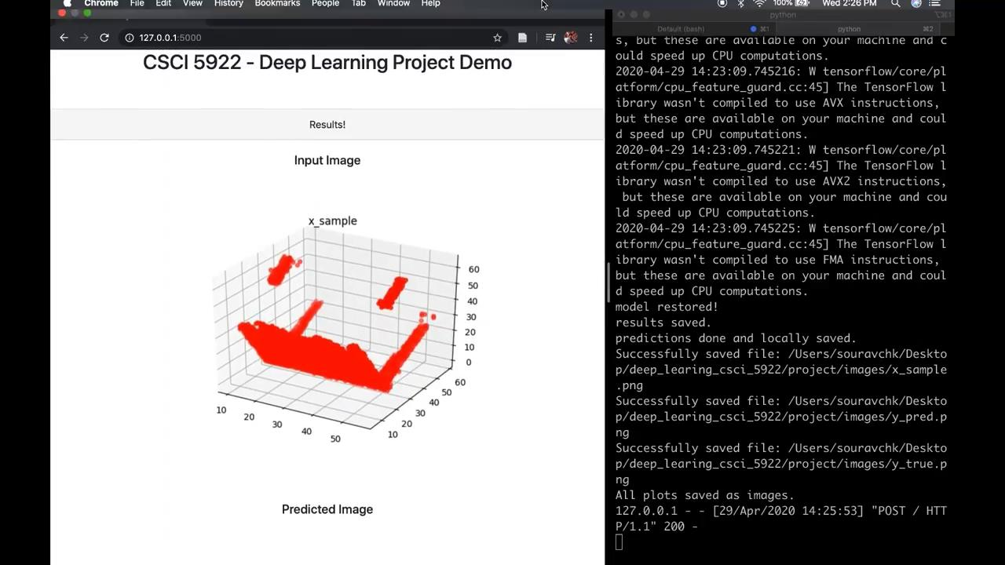
Demo
https://drive.google.com/file/d/1ziJFGpRXM_Fie9LFhBj9ypv2A2CZiX-W/view?usp=sharing

Slide 26
Work in Progress
Goal:
To improve the resolution of the output from the first model, from 256³ to 512³ resolution.
Two approaches:
Occupancy Networks
Implicit Fields for Generative Shape Modeling
Notes:
Usual representations: voxel, mesh, point
Occupancy Networks: new representation for 3D geometry based on learning a continuous 3D mapping
Implicit Fields: An implicit field assigns a value to each point in 3D space, so that a shape can be extracted as an iso-surface

Slide 27
Event Sequence Processing
Abhilash Jahagirdar, David Kim, Karthik Siddaramanna, Madhusudhan Aithal

Slide 28
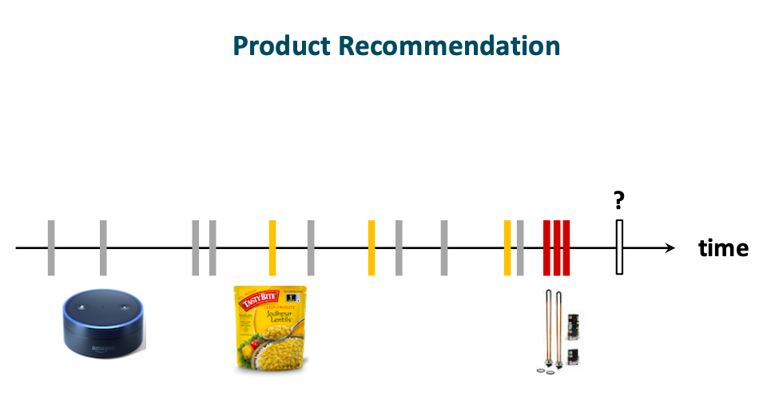
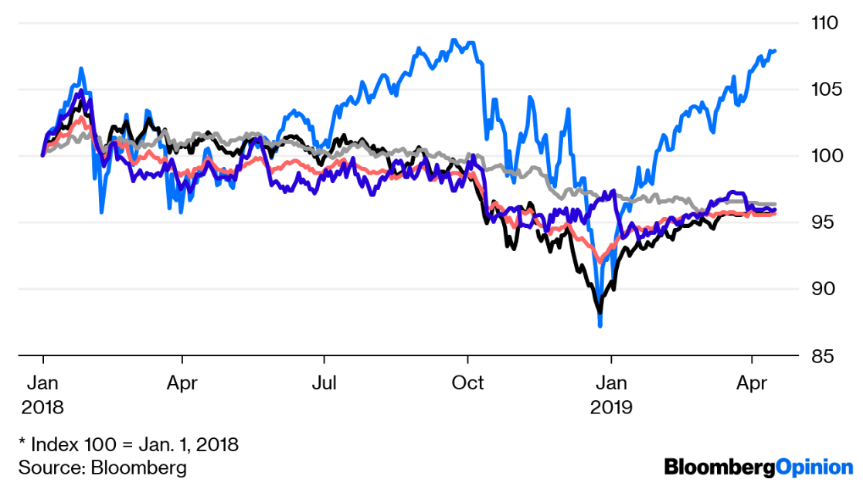
Is it possible to predict what and when you will retweet?
What is the difference of Time based and Event Based?(Mozer et al., 2017)
<Event based sequence example image
>
Notes:
Deterministic time intervals and indeterministic time intervals

Slide 29
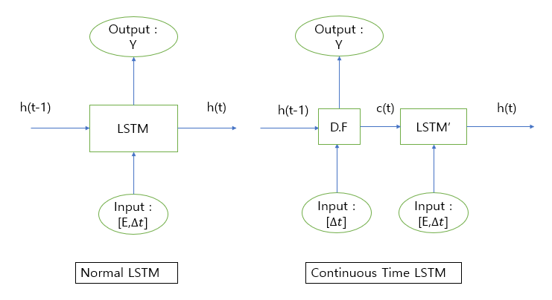
Can a Neural Network do a better job?
Initial approaches : Poisson Process, Hawkes Process
Our new approach is to use Neural Network to overcome these shortcomings.
CT-LSTM (Neural Hawkes Process) based on LSTM (Mei & Eisner, 2017)
Notes:
The problem with Poisson Process is that it assumes that all events is independent
The problem with Hawkes Process is that it all events influence other events positively and independently
LSTM uses h(t) to output
CT-LSTM gets H(t)

Slide 30
So what did we find out?
Values : Negative Log-Likelihood (lower the better)
For synthesized hawkes data the normal LSTM did better
For the Retweet data the CT-LSTM outperformed
Assume this is because of the difference of data structure
Data\Model | LSTM | CT-LSTM
Hawkes Data | 0.0092 | 1.3722
Retweet | 35.2689 | 6.1236
Reference
Mozer, Michael C. and Denis Kazakov. “Discrete-Event Continuous-Time Recurrent Nets.” (2017).
Hongyuan Mei and Jason Eisner. 2017. The neural hawkes process: a neurally self-modulating multivariate point process. In Proceedings of the 31st International Conference on Neural Information Processing Systems (NIPS’17). Curran Associates Inc., Red Hook, NY, USA, 6757–6767.

Slide 32
Visual QA Assistance for Visual Impairment
Akanksha Malhotra
Pratik Pramod Revankar
Piyush Mishra
CSCI 5922 - Spring ‘20

Slide 33
Overview
VQA is the approach in which textual and image data are combined to give natural language responses to an image scene.
We use a VQA model with a co-attention mechanism to explain both image and the question attention.
We propose this as an assistance tools for those suffering from visual impairments, where the user can give as an input the image scene and a natural language text,, to which our model replies with a natural language response. We aim to make this response “explainable” by giving more than just a “yes/no” or number response.

Slide 34
Dataset
VQA v2 enhanced balanced dataset built on top of the original VQA dataset by Antol et. al., which was originally built using the MS-COCO dataset
240K images
1100K questions
295K complementary pair list
VQA-E dataset built by Li et. al. which contains explanations for each image as annotations, and is better able to localize and understand the important regions in the image
108K images
269K questions
269K explanations

Slide 35
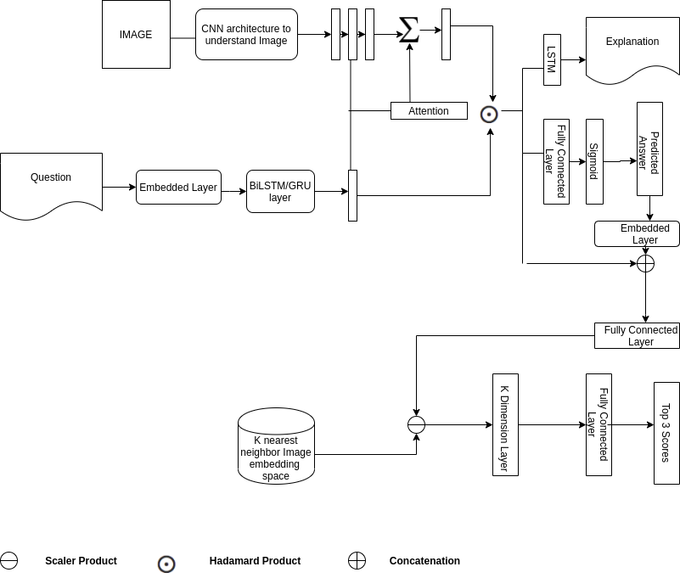
Architecture

Slide 36
References
[1] Antol, S., Agrawal, A., Lu, J., Mitchell, M., Batra, D., Lawrence Zitnick, C. and Parikh, D. Vqa: Visual question answering, Proceedings of the IEEE international conference on computer vision (pp. 2425-2433), 2015.
[2] Goyal, Y., Khot, T., Summers-Stay, D., Batra, D. and Parikh, D. Making the V in VQA matter: Elevating the role of image understanding in Visual Question Answering, Proceedings of the IEEE Conference on Computer Vision and Pattern Recognition (pp. 6904-6913), 2017.
[3] Lu, J., Yang, J., Batra, D. and Parikh, D. Hi-erarchical question-image co-attention for visual question answering. Advances in neural information processing systems (pp. 289-297), 2016.
[4] Fukui, A., Park, D.H., Yang, D., Rohrbach, A. Darrell, T. and Rohrbach, M. Multimodal compact bilinear pooling for visual question answering and visual grounding, arXiv preprint arXiv:1606.01847, 2016.
[5] Gunning, D. Explainable artificial intelligence (xai). Defense Advanced Research Projects Agency (DARPA), Web 2017.
[6] Li, Q., Tao, Q., Joty, S., Cai, J. and Luo, J. Vqa-e: Explaining, elaborating, and enhancing your answers for visual questions, Proceedings of the European Conference on Computer Vision (ECCV) (pp. 552-567). Vancouver, 2018.
[7] Lin, T.Y., Maire, M., Belongie, S., Hays, J., Perona, P., Ramanan, D., Doll ́ar, P. and Zitnick, C.L. Vqa-e: Microsoft coco: Common objects in context., European conference on computer vision (pp. 740-755). Springer, Cham. Vancouver, 2014

Slide 37
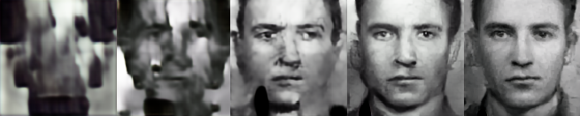
Turning Heads
with Generative Adversarial Networks
Derek Mease

Slide 38
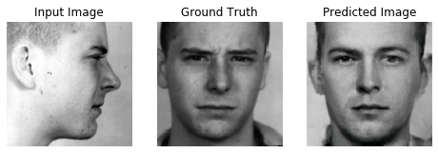
Head Rotation
Goals:
Given a 90-degree profile image of a person, generate a frontal view image.
Maintain fine details for a visually convincing output.
Maintain subject’s identifying characteristics for use with facial recognition.
GAN Architectures:
Pix2Pix
TP-GAN
Example of TP-GAN synthesis

Slide 39
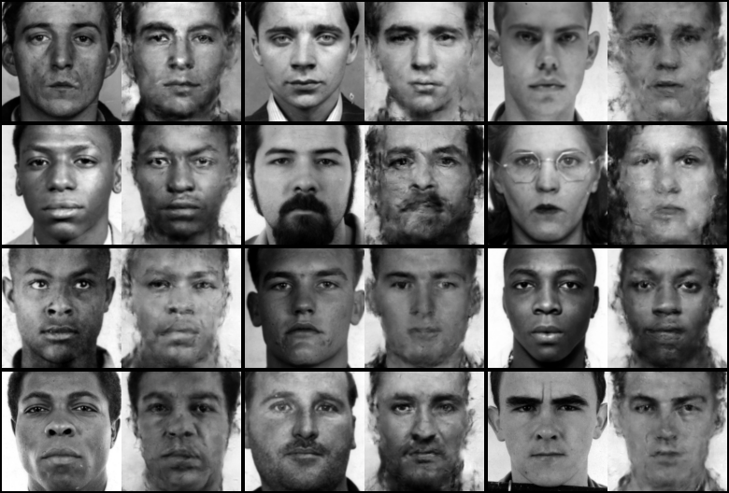
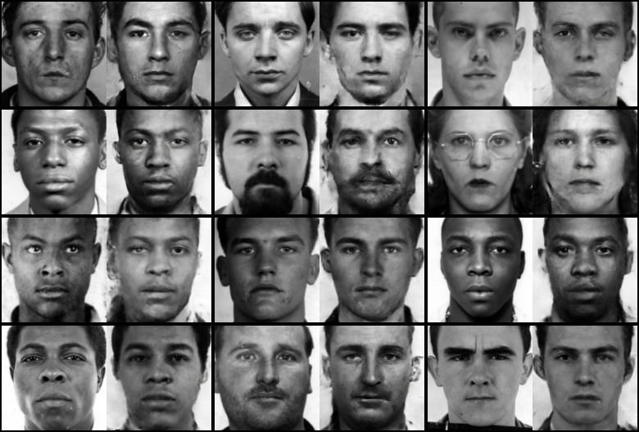
Pix2Pix
Pix2Pix uses only adversarial and L1 loss.
Quality can be improved by incorporating identity-preserving loss and symmetry loss.
Pre-trained LightCNN for identity feature extraction.
Loss includes MAE of features extracted from ground truth and synthesized images.
Vanilla Pix2Pix
Pix2Pix w/ Identity-preserving Loss

Slide 40
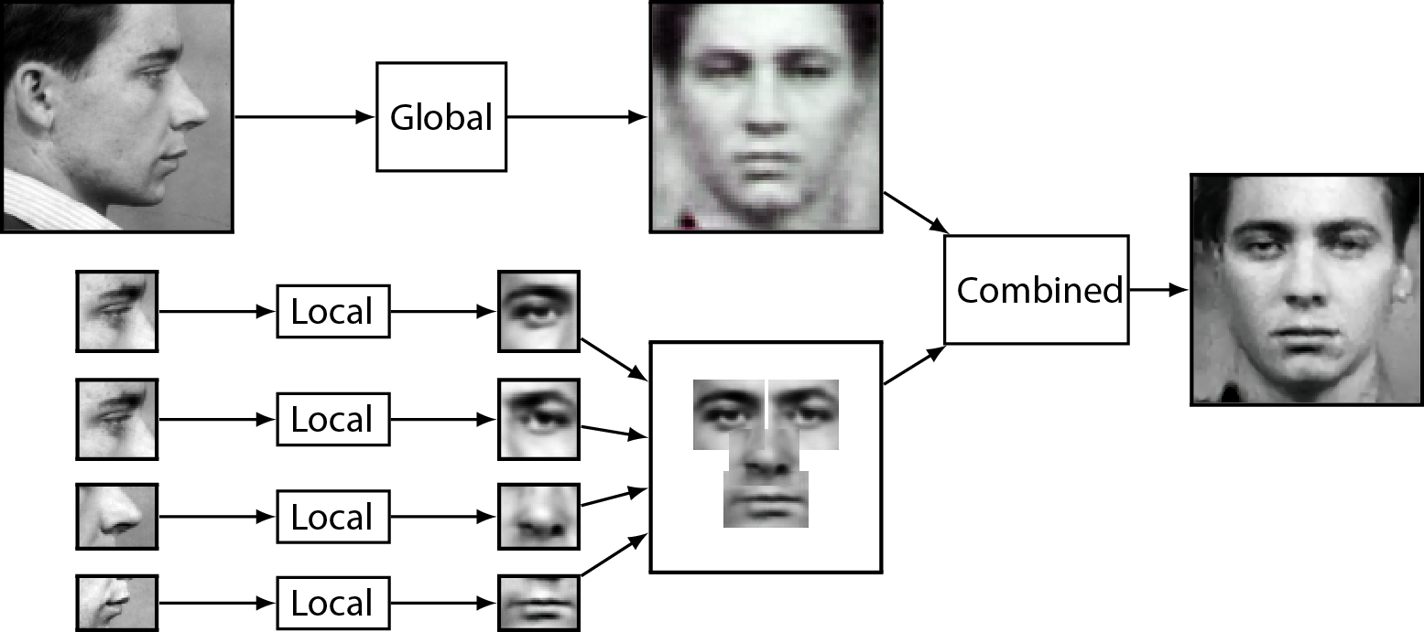
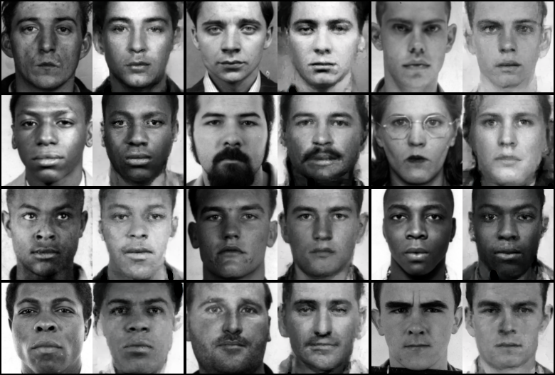
TP-GAN
Multiple CNN paths perform global and local rotations, which are combined in later convolutional layers.
Loss:
Adversarial
L1
Identity-preserving
Symmetry
Total Variation

Slide 41
Neural Image Captioning
CSCI 5922
Abhas Prasad
Aakarsh Fadnis
Biljith Thadichi

Slide 42
Overview
A quick look at a picture is enough for a person to describe in detail the image and the scene within, while the same cannot be said about a machine trying to describe a picture.
Can we write a computer program that takes an image as input and produces a relevant caption?
Image captioning is generating captions for images which describes what the image contains in a semantically and grammatically correct manner
Deep Learning + Required dataset

Slide 43
Motivation / Understanding the problems
01
Visual Aid for visually challenged - scenery and image descriptor
02
Security : CCTV capture for raising alarms for suspicious activities
03
Self-driving cars

Slide 44
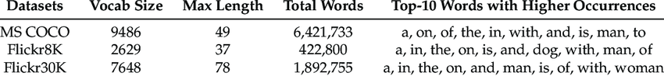
Dataset
MS COCO
Object segmentation information rather than just bounding boxes of objects
Five textual captions per image
Flickr
Five textual captions per image

Slide 45
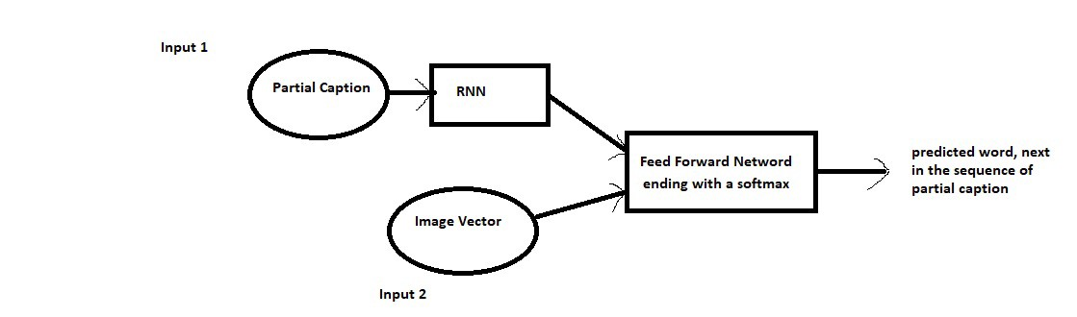
Model Architecture

Slide 46
Evaluation - BLEU scores
BLEU (bilingual evaluation understudy) is an algorithm for evaluating the quality of text which has been machine-translated from one natural language to another.
N-gram overlap between machine translation output and reference translation
Compute precision for n-grams of size 1 to 4
Add brevity penalty (for too short translations)
Typically computed over the entire corpus, not single sentence

Slide 47
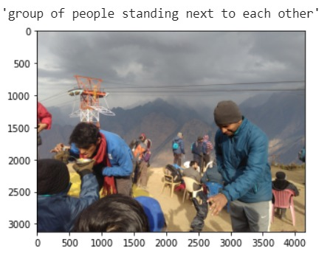
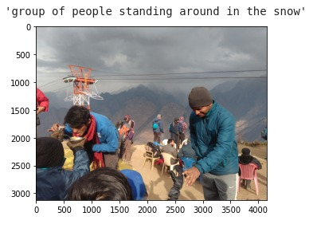
Results
Below is prediction is with training data of around 24,000 images
Below is the prediction for the same image with training data of 66, 000 images

Slide 48
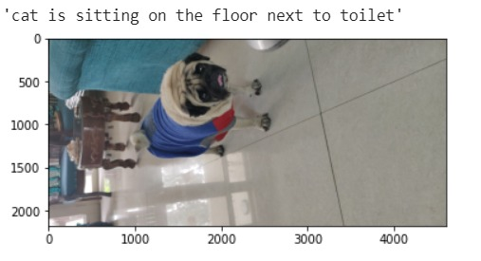
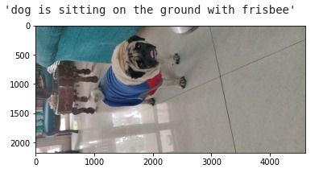
Results - 2
Hmmmmmmmmmmmm (24K)
Our Model is not the best one out there yet (66K)

Slide 49
GeoGuessrLSTM
Nirvan S.P. Theethira
Dheeraj Ravindranath

Slide 50
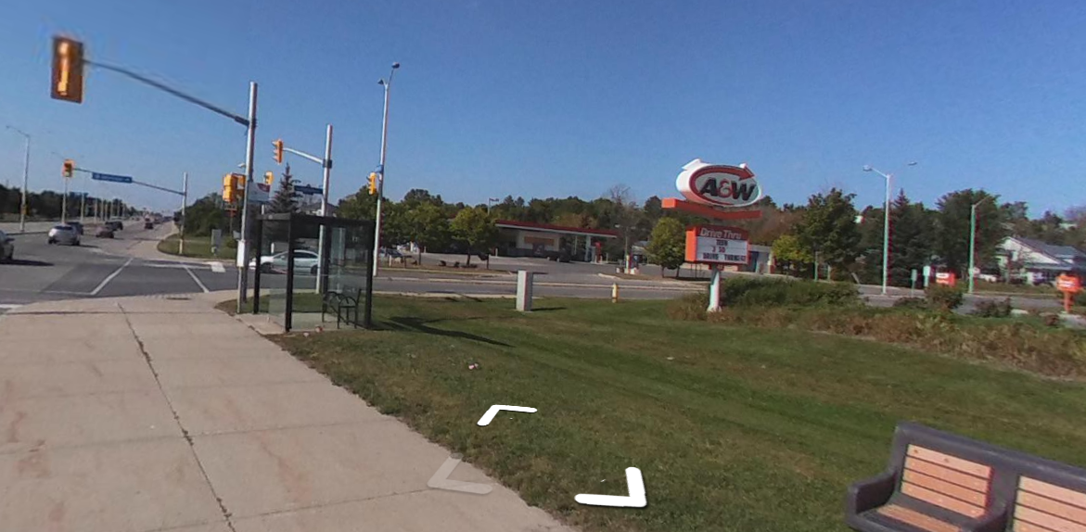
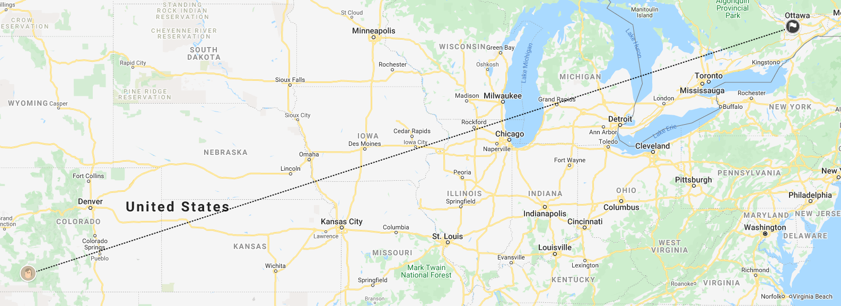
Goal
Geolocation is the identification or estimation of real-world location using geographic data.
Geolocation of google street view images.
Geoguessr scores players based on guessed location of street view images.
Can an AI play Geoguessr ?

Slide 51
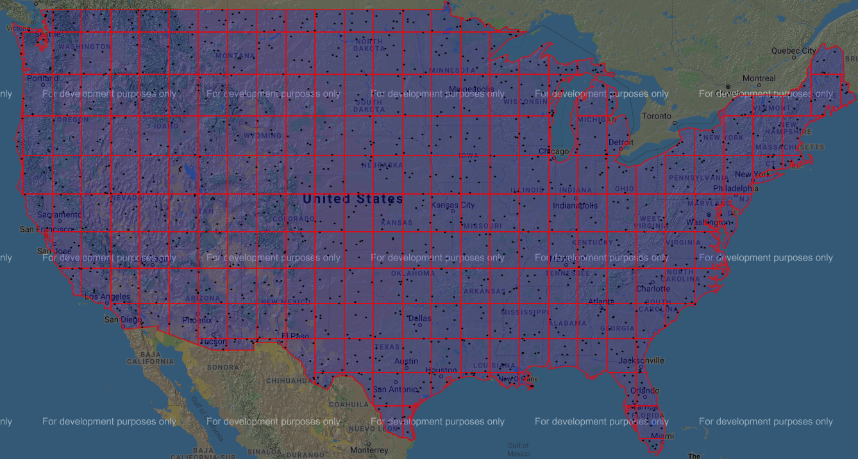
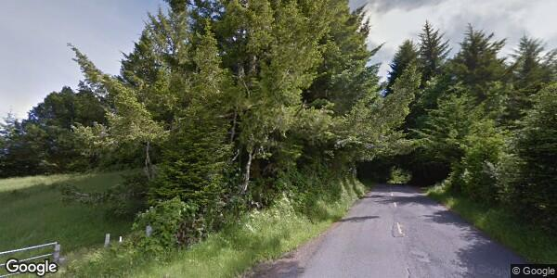
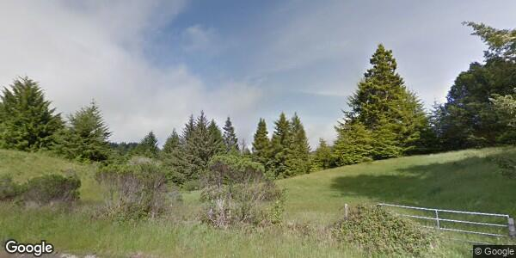
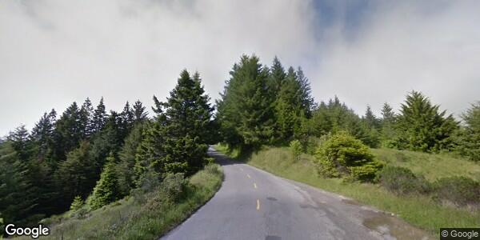
Data collection
Each square is 4 sq units or 138 sq miles.
A total of 243 grids are created.
9170 location street views scraped
Street view static API

Slide 52
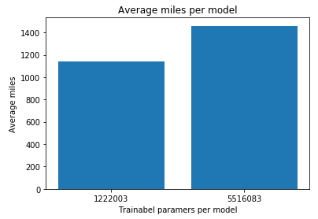
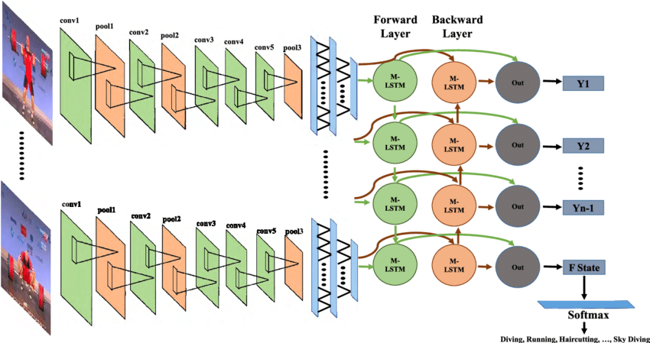
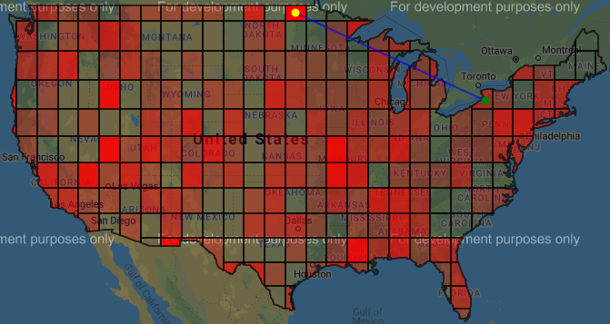
Machine learning

Slide 53
Learning from Sub-words - Experiments in Automated Essay Scoring
Adam Pollins
Kedar More
Parth Jawale
Saptarshi Mitra
Srishti Rawal

Slide 54
ASAP-Automated Essay Scoring (AES) Task
Most automated essay scoring research today makes use of the Automated Student Assessment Prize’s (ASAP) dataset (2012)
Three types of essays: argumentative/persuasive, source-dependent responses, narrative/descriptive
This dataset is widely used because of the diversity of essay types (intra- and inter- categorically comparable), diversity of score ranges and scoring rubrics and presence of leverageable prompt texts
One disadvantage is that most of the essays only have an overall score, but no attribute-wise scores

Slide 55
Our Work
Goals:
Obtain a canonical representation of misspellings, Out-of-Vocabulary (OOV) words in all of the training essays
Propose alternative tokenization strategies to deal with the misspellings, OOV words
Explore ways to plug said tokenization methods into a neural architecture
Compare performance metrics on various architectures to test the effectiveness of our approach
We are here

Slide 56
Establishing Baselines
Prompts | Accuracy (Exact Agreement) | Cohen’s Kappa (Inter-rater Agreement)
1 | 0.65 | 0.70
2 | 0.66 | 0.65
3 | 0.64 | 0.59
4 | 0.65 | 0.71
5 | 0.58 | 0.74
6 | 0.62 | 0.77
7 | 0.44 | 0.67
8 | 0.17 | 0.59
Baseline model is single layer feedforward neural network, and the results are averaged over 5 runs of the model
We run four experiments for LSTMs and CNNs (two with naive word-tokenizers and two with SentencePiece’s subword tokenization)
We hypothesize that with our models that use a subword vocabulary (with size half that of word tokens), we should be able to achieve significant gains on our performance metrics

Slide 57
Language Style Transfer
Rahul Aedula, Shipra Behera, Karthik Palavalli, Lakshya Sharma

Slide 58
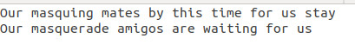
Problem Statement
To create a rendition of shakespearean plays to urban slang using deep learning techniques.

Slide 59
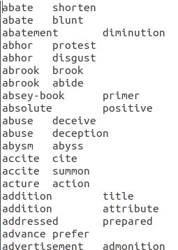
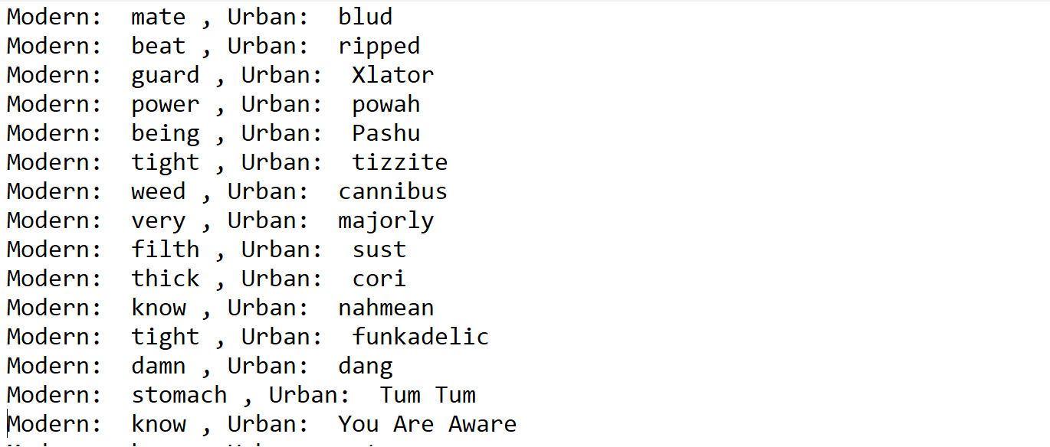
Dataset
Collection of modern paraphrases of Shakespeare’s plays. The dataset is freely available on Github.
For the urban dictionary, we are using this Kaggle dataset. (2.5 million rows)
Cosine distance metric is used to reduce the urban dictionary description to a single word definition
Train data 14 plays with 18395 sentences.
Validation 1 play with 1218 and Test 1 play 1462 sentences.

Slide 60
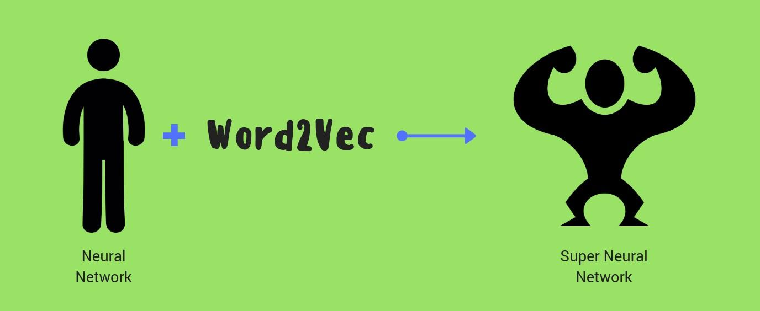


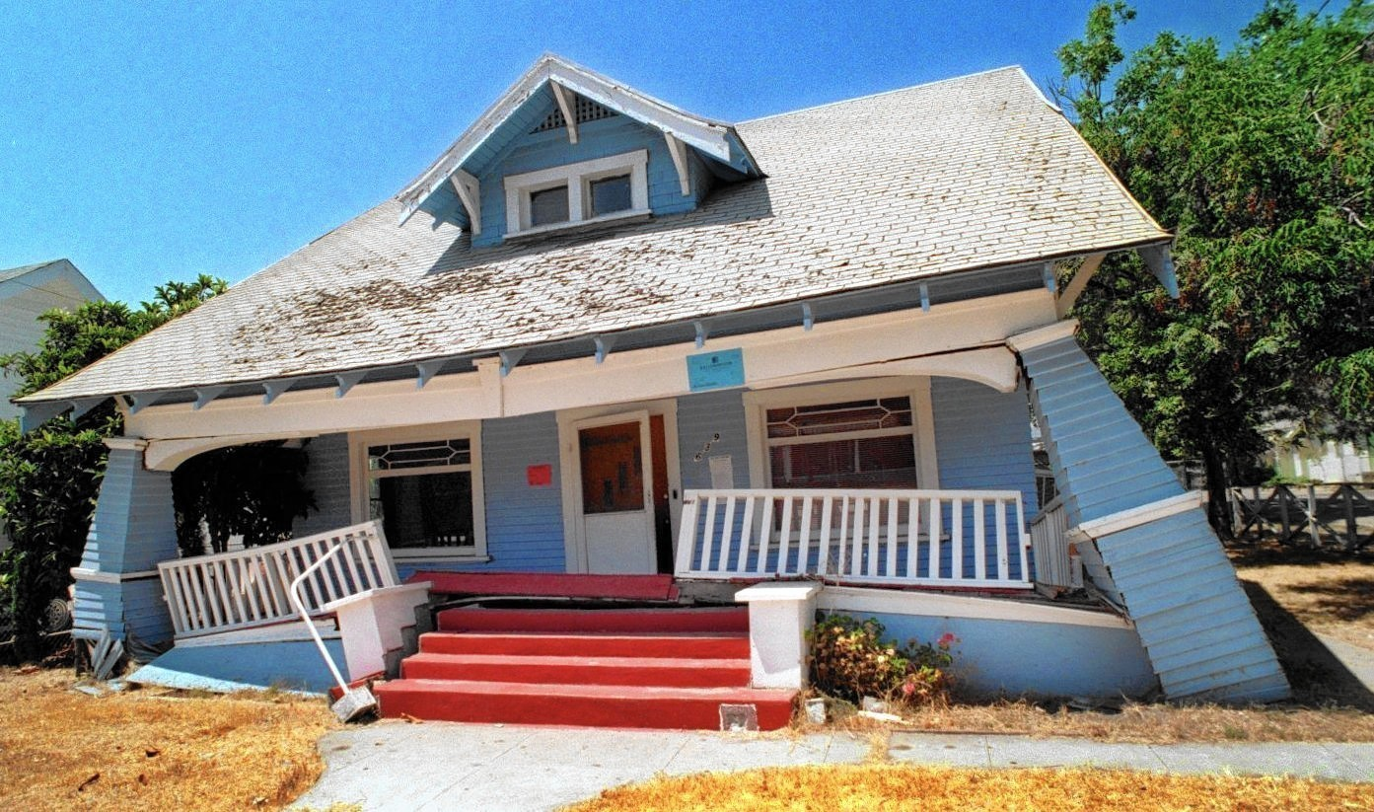
Pre-trained Embeddings
Glove
RetroExt
Word2Vec

Slide 61
Context Vector
RNN
RNN
Decoder States
Attention Weights
p
Weight given to the decoder RNN module while computing output probabilities
p: Output probability of a token w at step t is a weighted sum of probabilities from decoder LSTM model Cross entropy loss
M-dimensional embedding vectors
Encoder States

Slide 62

Encoder
Forward and reverse encoder.
Addition to combine the forward and reverse encoder states.
Notes:
Wout and b_out are the weight and bias matrices for the output layer.

Slide 63

Attention and Decoder
An RNN based Decoder is used.
A normalized attention weight vector is computed using the previous decoder hidden state and encoder representations.
The context vector is a summation of encoder states weighted by corresponding attention weights.
The decoder layer gives the current state based on the hidden state of the previous time step and the true label for the previous time step.
Finally a softmax is done over the current state predictions.
Notes:
Wout and b_out are the weight and bias matrices for the output layer.

Slide 64
Additional approaches to explore
Pointer network
BERT Embeddings

Slide 65
References
Jhamtani, Harsh et al. “Shakespearizing Modern Language Using Copy-Enriched Sequence-to-Sequence Models.” ArXiv abs/1707.01161 (2017): n. Pag.
Faruqui, Manaal, et al. "Retrofitting word vectors to semantic lexicons." arXiv preprint arXiv:1411.4166 (2014).
Mikolov, Tomas et al. “Distributed Representations of Words and Phrases and their Compositionality.” ArXiv abs/1310.4546 (2013): n. Pag.
JeffreyPennington, RichardSocher, and ChristopherD Manning. "Glove: Global vectors for word representation." Conference on Empirical Methods in Natural Language Processing. 2014.

